Slide 1


Classifying Shooting Incident Fatality in New York City
leveraging machine learning for predicting shooting incident fatalities.
Presented by Rupin Sharma

Slide 2
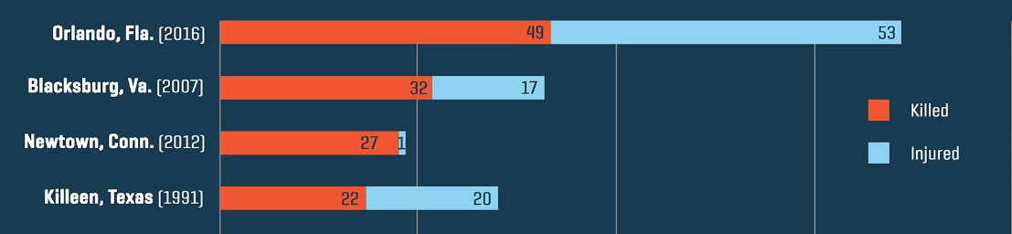



Introduction
The public safety sector is evolving rapidly, influenced by technological advancements, changing urban dynamics, and a growing need for data-driven decision-making.
Shooting incidents, particularly the fatal ones, pose significant challenges and opportunities for law enforcement agencies. When a shooting incident results in a fatality, it has a profound impact on community safety, public trust, and the strategic allocation of police resources.
Machine learning, with its predictive capabilities, offers a transformative approach to understanding and mitigating the challenges posed by shooting incidents.
Through data-driven insights and predictive modeling, this presentation aims to showcase my Machine Learning Capstone Project focused on predicting shooting incident fatality in New York City.

Slide 3

Why Public Safety Domain?
The public safety sector is a unique blend of community well-being, technology, and regulatory frameworks, presenting its own set of distinct challenges and opportunities. I chose the Public Safety Domain for my Capstone Project because:
Community Impact: Public safety directly affects the quality of life in communities. Understanding and predicting incidents can help save lives and enhance community trust.
Confidentiality: Handling sensitive incident data requires utmost care. Ensuring data privacy and security while analyzing it is a complex but crucial task.
Diverse Incidents: Public safety incidents vary widely. Developing models to manage and predict such a diverse range of incidents adds another layer of complexity.

Slide 4
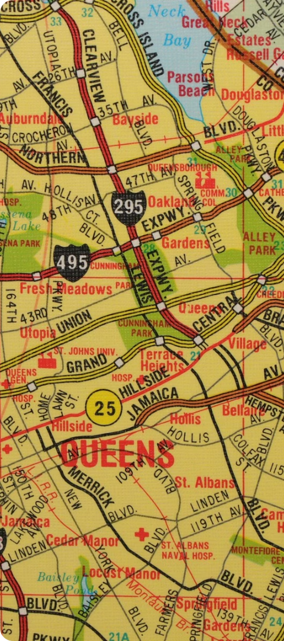
Project’s Significance and Benefits to Law Enforcement
1
Enhanced Community Safety:
Anticipating fatal incidents allows for proactive strategies, improving response times and community safety.
2
Resource Optimization:
Predicting and mitigating fatal incidents is cost-effective, ensuring efficient allocation and utilization of police resources.
3
Risk Mitigation:
Identifying potential fatal incidents mitigates risks, enabling preventive measures and strategic interventions.
4
Market Competitiveness:
Predictive incident management positions law enforcement agencies as proactive and community-centric, offering a competitive edge through improved public trust and safety.
5
Long-Term Community Trust:
By predicting and addressing fatal incidents, my project contributes not only to public safety but also to the broader objectives of law enforcement, fostering community trust and ensuring long-term societal well-being.

Slide 5
Dataset Information
Here are the key details about the dataset used in this project:
Column Name | Description
INCIDENT_KEY | Unique identifier for each incident
OCCUR_DATE | Date of the incident
OCCUR_TIME | Time of the incident
BORO | Borough where the incident occurred
LOC_OF_OCCUR_DESC | Description of the location of occurrence
PRECINCT | Police precinct where the incident was reported
JURISDICTION_CODE | Jurisdiction code for the incident
LOC_CLASSFCTN_DESC | Location classification description
LOCATION_DESC | Detailed location description
STATISTICAL_MURDER_FLAG | Indicator if the incident was a murder
PERP_AGE_GROUP | Age group of the perpetrator
PERP_SEX | Sex of the perpetrator
PERP_RACE | Race of the perpetrator
VIC_AGE_GROUP | Age group of the victim
VIC_SEX | Sex of the victim
VIC_RACE | Race of the victim
X_COORD_CD | X-coordinate of the incident location
Y_COORD_CD | Y-coordinate of the incident location
Latitude | Latitude of the incident location
Longitude | Longitude of the incident location
Lon_Lat | Combined longitude and latitude
Number of records: Our dataset comprises a robust collection of data, consisting of over 23,000 records. Each record represents a unique shooting incident, contributing to the richness and depth of our analysis.
Features/Columns: The dataset is characterized by a diverse set of features, each providing valuable insights into shooting incidents, their locations, and outcomes. In total, there are 21 features/columns that form the basis of our predictive modeling.
Source of the Data: The dataset is sourced from the New York Police Department (NYPD), provided by the institute, ensuring reliability and relevance. The data's origin plays a crucial role in shaping the context and ensuring that our analysis is grounded in real-world scenarios and industry dynamics.

Slide 6

Preprocessing
1. Initial Data Cleaning
First, we made sure there were no null values and duplicates in the dataset
Null Values: Verified that there were no null values in the dataset.
Duplicates: Ensured there were no duplicate records, maintaining the integrity of our data.
2. Feature Evaluation
Column Relevance: We evaluated all columns to determine their usefulness for our analysis.
Dropped Columns: Columns like “INCIDENT_KEY” and “LOC_OF_OCCUR_DESC” weren't contributing much to the predictions, so we decided to drop them during preprocessing.
3. Handling Categorical Variables
Categorical to Numerical:
The " STATISTICAL_MURDER_FLAG" column was categorical variables. We converted these categorical features into numerical format using label encoding to make them compatible with our model.

Slide 7
Exploratory Data Analysis (EDA)
EDA Insights: ( Visualizations)
Visualizations were essential in providing a clear representation of the data. They offered insights into patterns and helped identify factors contributing to fatal shooting incidents.
• Feature Distribution: Analyzed the distribution of features to understand their characteristics.
• Correlation Analysis: Highlighted correlations between features using Heatmaps
• PCA Scatter Plot: Visualized the data before and after removal of outliers.
By performing a thorough EDA, we ensured our dataset was ready for predictive modeling, providing a solid foundation for developing our machine learning model.
Columns Worked With:
PRECINCT, JURISDICTION_CODE, STATISTICAL_MURDER_FLAG, X_COORD_CD, Y_COORD_CD, Latitude, Longitude

Slide 8
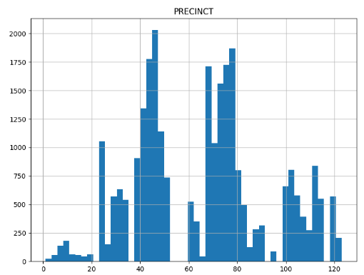
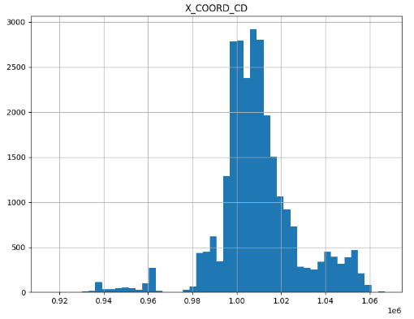
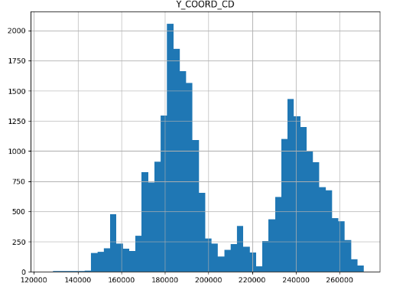
Visualizations
Feature Distribution: The histograms display the distribution of key numerical columns in the dataset, specifically 'PRECINCT', 'X_COORD_CD', and 'Y_COORD_CD'.
PRECINCT: This histogram shows the distribution of shooting incidents across different police precincts in New York City. It helps in identifying precincts with higher or lower frequencies of incidents.
X_COORD_CD and Y_COORD_CD: These histograms illustrate the distribution of the geographical coordinates of shooting incidents. They provide insights into the spatial spread and concentration of incidents based on their x and y coordinates.

Slide 9
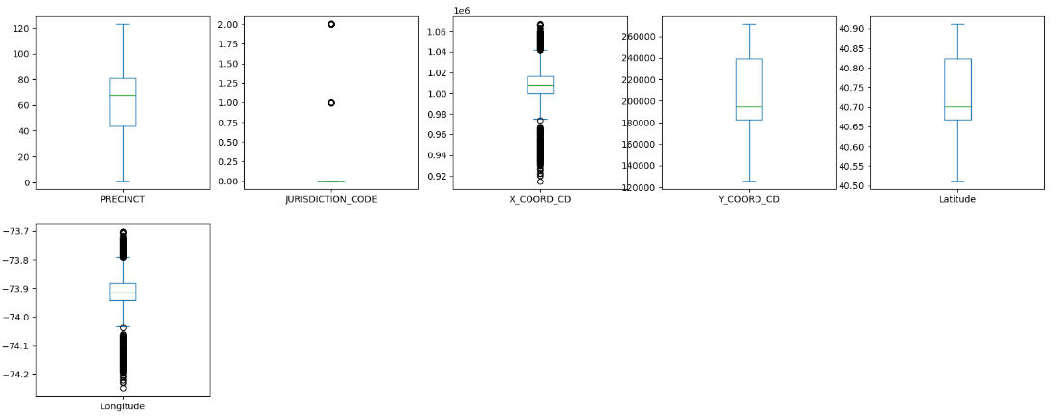
Visualizations
Boxplots are essential for visualizing the distribution of numerical features and identifying outliers within the dataset. Outliers can significantly affect the performance of machine learning models, so it is crucial to detect and handle them appropriately.
Observations
PRECINCT: The precinct column shows a fairly even distribution with no significant outliers.
JURISDICTION_CODE: The jurisdiction code column has a few noticeable outliers which could indicate special cases or anomalies in the dataset.
X_COORD_CD and Y_COORD_CD: Both X coordinate column show a large number of outliers. This might indicate data entry errors or rare but valid occurrences. where as in Y coordinate there aren’t outliers seen.
Latitude and Longitude: The longitude columns also display several outliers, which could be due to incorrect data entries or actual rare geographical points. where as in latitude column there aren’t outliers seen.

Slide 10
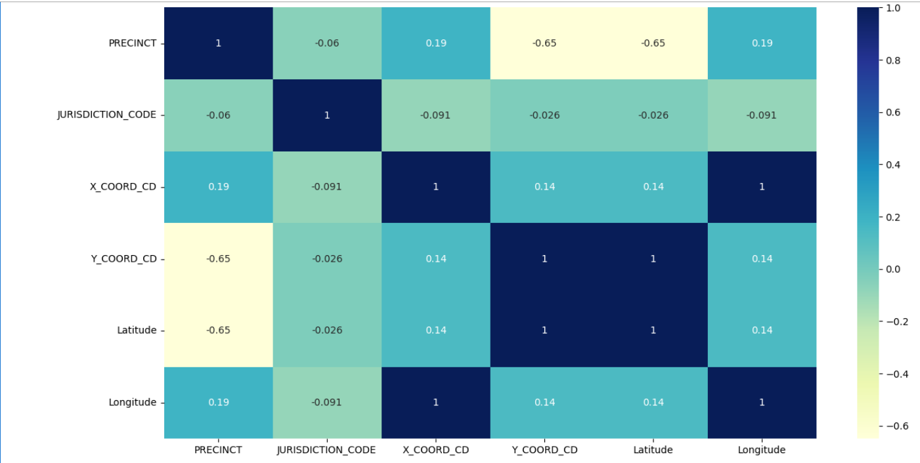
Visualizations
By leveraging correlation analysis through a heatmap, we gain valuable insights into the interrelationships between features, guiding us in building a more robust and accurate predictive model.
Observations
PRECINCT and Y_COORD_CD/Latitude: There is a strong negative correlation between PRECINCT and Y_COORD_CD/Latitude, indicating that certain precincts are more associated with specific latitude positions.
X_COORD_CD and Longitude: These features have a perfect positive correlation, as expected, since they represent the same spatial dimension.
Other Features: Most other features show low or moderate correlations with each other, suggesting that they provide unique information to the model.

Slide 11
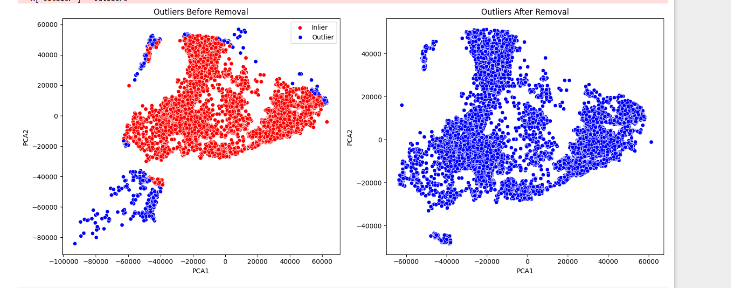
Visualizations
PCA (Principal Component Analysis): PCA was used to reduce the dimensionality of the dataset to two principal components (PCA1 and PCA2) for easy visualization.
Visualization: The scatter plot visualizes the data points in the new PCA space, highlighting outliers in red and inliers in blue.
Observations
Before Removal: The left plot shows the dataset with outliers included. blue points represent the outliers detected, while red points represent the inliers.
-Outliers can be observed scattered around the inliers, indicating potential anomalies or errors in the data.
After Removal: The right plot shows the dataset after removing the outliers.
- The cleaned data (in blue) appears more compact and consistent, with fewer scattered points, indicating a more reliable dataset for model training.

Slide 12
Splitting the data into X and y
Splitting the Data into Training and Testing Sets In this step, we partitioned the dataset into two components: X and y.
Variable X: This includes all the independent variables or features that contribute to our predictions. It encapsulates the input data for the model.
Variable y: This represents the dependent variable or target variable, which is the outcome we aim to predict. It encapsulates the output data for the model.
Train-Test Split
To evaluate the performance of our model, we split the dataset into training data and testing data.
Split Ratio: We used an 80:20 split, meaning 80% of our data is used as training data and 20% is used as testing data. This means the test size was set to 0.2.
Random State: We used a random state of 42 to ensure the reproducibility of our results across different runs. This means that every time we run the code, we get the same split, ensuring consistency in our evaluations.
Stratify: We used stratify=y to ensure that our target variable (y) is distributed proportionally in both the training and testing sets.

Slide 13
Standard Scaler
Scaling Numerical Features:
To ensure consistent scales for numerical features, we employed Standard Scaler during preprocessing.
This helped in normalizing the features, ensuring they contribute equally to the model's predictions.

Slide 14
Applying Machine Learning Algorithms
This is a Binary Classification problem, the models used are:
Logistic Regression
When faced with binary classification problems, logistic regression can be used to model the probability of a binary response depending on any number of explanatory variables. - For this dataset, it forecasts whether an occurrence is statistically a homicidal based on certain features.
Decision Tree
Classification and regression tasks can be accomplished using decision trees which learn simple decision rule from data features. - For this dataset, it lets one identify different rules and patterns that exist between outcomes in shooting cases.
Random Forest
Random Forest is an ensemble method that combines multiple decision trees for better classification accuracy and to avoid over fitting. - For this dataset, its results are more accurate compared to single decision tree alternatives as it ensembles results from multiple random trees.
Support Vector Machine (SVM)
For classification purposes, SVM computes the best hyperplane that can separate classes within feature space. - For this dataset, the goal is to have maximum difference from each other among various types of incidents.
Naive Bayes
Naive Bayes is a classification algorithm based on Bayes’ theorem with assumption of independence between predictors. - This dataset contains a basic yet powerful classifier with probabilistic approach for determining class label
Gradient Boosting:
Gradient Boosting is an ensemble technique that builds models sequentially to correct the errors of the previous models, enhancing accuracy. For this dataset, it incrementally improves the classification performance by focusing on difficult-to-classify incidents

Slide 15
Evaluation Metrics
Before Removal of Outliers
Model | Accuracy | Precision | Recall | F1 Score
Logistic Regression | 0.814469 | 0.000000 | 0.000000 | 0.000000
Decision Tree | 0.710623 | 0.170732 | 0.145114 | 0.156884
Random Forest | 0.798535 | 0.219355 | 0.033564 | 0.058219
SVM | 0.814469 | 0.000000 | 0.000000 | 0.000000
KNN | 0.775275 | 0.209239 | 0.076012 | 0.111513
Gradient Boosting | 0.813919 | 0.200000 | 0.000987 | 0.001965
Naive Bayes | 0.813370 | 0.000000 | 0.000000 | 0.000000

Slide 16
Evaluation Metrics
After Removal of Outliers
Model | Accuracy | Precision | Recall | F1 Score
Logistic Regression | 0.8175 | 0.0000 | 0.0000 | 0.0000
Decision Tree | 0.7548 | 0.2496 | 0.1711 | 0.2030
Random Forest | 0.7764 | 0.2956 | 0.1626 | 0.2098
Gradient Boosting | 0.8177 | 1.0000 | 0.0011 | 0.0021
SVM | 0.8175 | 0.0000 | 0.0000 | 0.0000
Naive Bayes | 0.8175 | 0.0000 | 0.0000 | 0.0000
KNN | 0.7818 | 0.2559 | 0.1024 | 0.1463

Slide 17
changes in the metrics
Accuracy: The accuracy of most models decreased slightly after removing outliers, except for Gradient Boosting which increased slightly.
Precision: The precision of most models remained the same or decreased slightly after removing outliers. Gradient Boosting had a significant increase in precision.
Recall: The recall of most models increased after removing outliers, with Decision Tree and Random Forest showing the largest improvements.
F1-Score: The F1-score of most models increased after removing outliers, with Decision Tree and Random Forest showing the largest improvements.

Slide 18
Explanation of Model Selection
Why Not Use Accuracy Alone?
Logistic Regression, Support Vector Machine, Naive Bayes:
Accuracy: 0.8175 Precision, Recall, F1 Score: 0.0000
The accuracy is high, but these models fail to predict the positive class at all, leading to zero precision, recall, and F1 score. This suggests that these models might be predicting all instances as the negative class, which can still yield high accuracy if the dataset is imbalanced (i.e., the negative class is much more frequent than the positive class).
Gradient Boosting:
Accuracy: 0.8177
Precision: 1.0000 (likely due to predicting very few positives correctly)
Recall: 0.0011
F1 Score: 0.0021
Gradient Boosting has slightly higher accuracy, but it also has a very low F1 Score, indicating that its predictions for the positive class are almost negligible.
Importance of the F1 Score
The F1 Score is particularly useful in the context of imbalanced datasets as it balances precision and recall. A high F1 Score indicates that the model is performing well in predicting both the positive and negative classes.

Slide 19
Explanation Model Considerations
Random Forest Selection
Random Forest:
Accuracy: 0.7764
Precision: 0.2956
Recall: 0.1626
F1 Score: 0.2098
Random Forest does not have the highest accuracy, but it has the highest F1 Score among the models, indicating a better balance between precision and recall. This suggests that Random Forest is more capable of identifying the positive class correctly compared to the other models, making it more reliable for practical use.
a very low F1 Score, indicating that its predictions for the positive class are almost negligible.
Conclusion
The model selection is based on the F1 Score because it provides a more holistic view of the model's performance in scenarios where the dataset is imbalanced. Random Forest was chosen as the best model because it has the highest F1 Score, indicating better performance in predicting the positive class compared to other models that might be overfitting to the majority class.
Choosing a model based solely on accuracy can be misleading in such scenarios, leading to models that do not effectively address the problem of interest.

Slide 20
Technical Implementation
Model Inference Pipeline:
The predict function loads the trained machine learning model and scales input data for prediction.
Predictions classify whether a shooting incident is a murder based on the provided coordinates.
User-Friendly Interface:
Using Gradio, we created an accessible interface for users to input coordinates and receive predictions.
The interface includes inputs for X_COORD_CD, Y_COORD_CD, Latitude, and Longitude, and outputs a text classification.
The tool is designed to be shared and utilized easily, promoting wider adoption and usage.

Slide 21
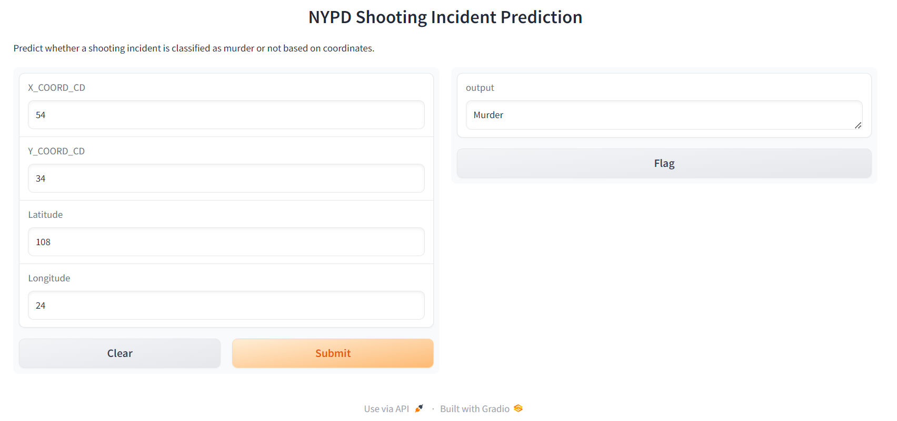
Conclusion
Prediction platform :
By integrating Machine Learning with user-friendly tools, we provide valuable insights and proactive solutions for public safety. This project exemplifies the power of predictive analytics in addressing complex societal issues and underscores the importance of data-driven strategies in enhancing operational efficiency and public safety. By implementing such a solution, we can significantly contribute to making our cities safer through advanced analytics and innovative technology solutions

Slide 22
Thank You!!

